Slide 1
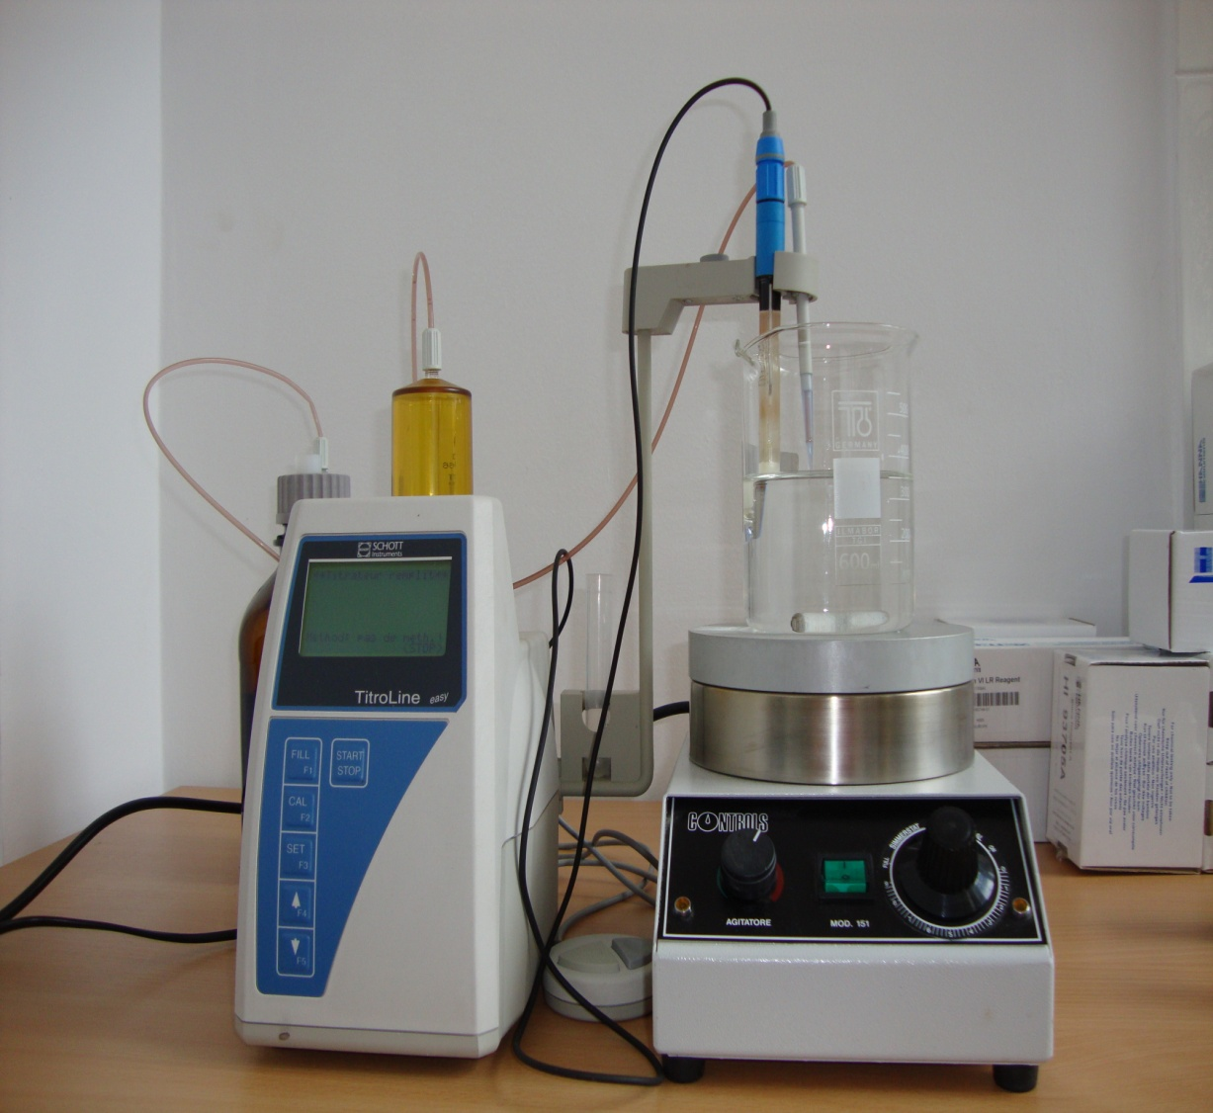
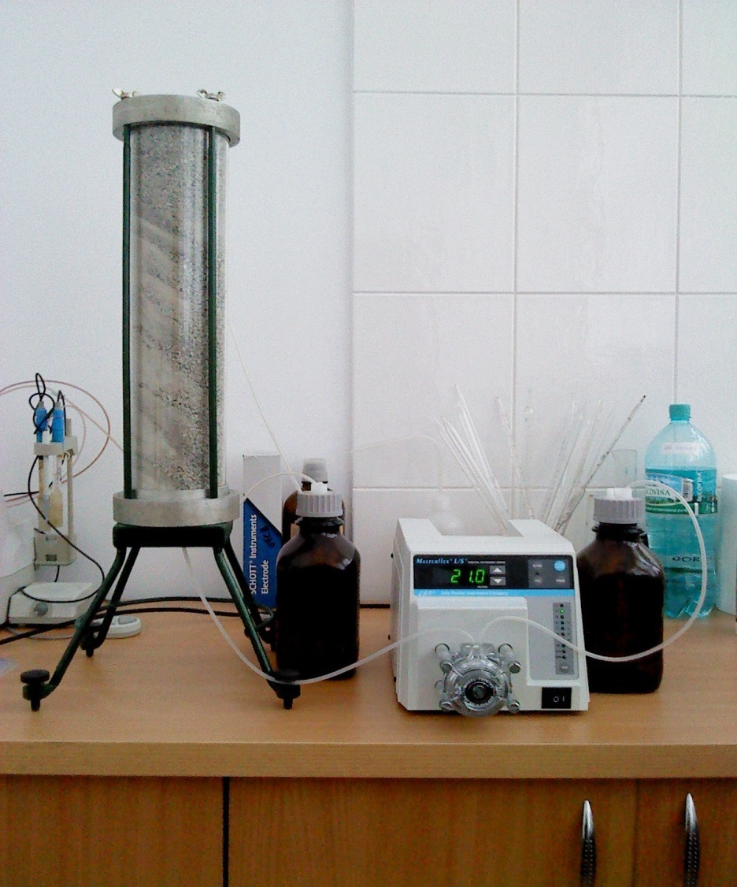
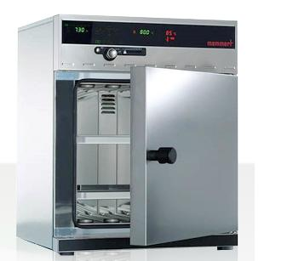
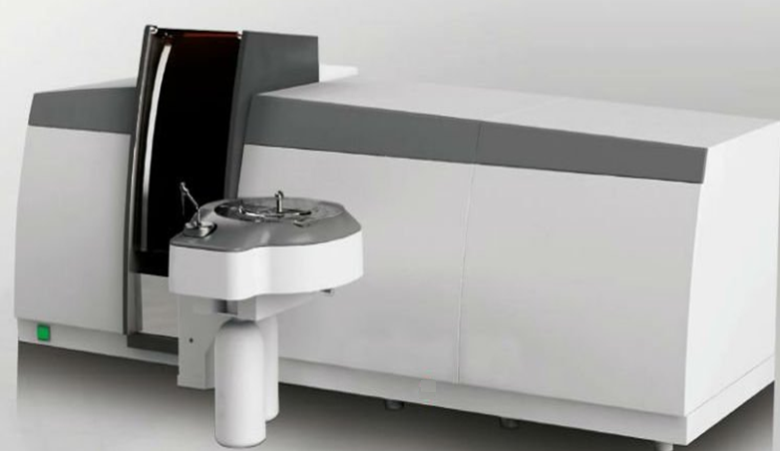
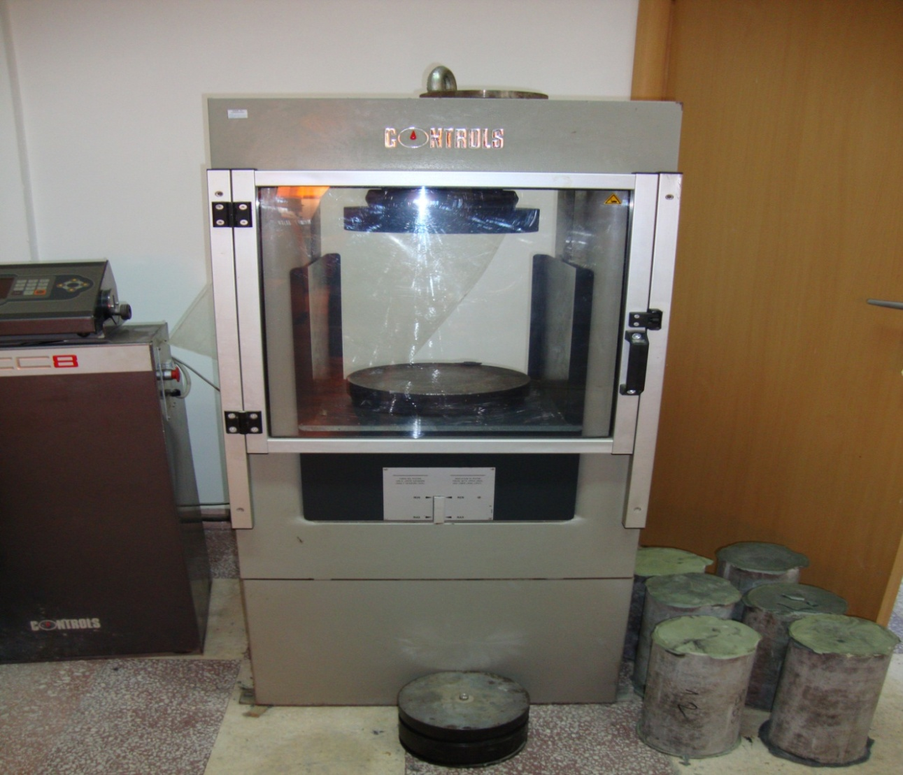
VADEMC
TECHNICAL UNIVERSITY OF CIVIL ENGINEERING
Research Center of Mineral Waste Valorisation into Construction Materials
Bd. Lacul Tei 124 * Sector 2 * RO-020396 * Bucureşti - ROMÂNIA
Tel.: +40-21-242.12.08, Fax: +40-21-242.07.81
Research Center of Mineral Waste Valorisation into Construction Materials (CC-VADEMC) includes professor-researchers from the Technical University of Civil Engineering Bucharest, from Romania and abroad collaborators with important research activities on the mineral resources management in construction.
The evaluation of the waste recycling technological, environmental and economic advantages /limitation
The recovery (treatment) of industrial waste as secondary raw materials (SRMs) into conventional and advanced construction materials
INVESTIGATING– IDENTIFYING
PROCESSING
THE TECHNICAL / SCIENTIFIC OFFER
DEVELOPMENT OF THE RECOVERY & RECYCLING TECHNOLOGICAL PROCESS
TESTING OF THE CONSTRUCTION MATERIALS ENGINEERING AND ENVIRONMENTAL PROPERTIES
Life cycle assessment
Achievements: required mechanical strengths and durability, immobilization of heavy metals into hydraulic matrix
Automatic titrator TitroLine Easy;
Vacuum Pump Rocker 410;
Masterflex 7524-55 peristaltic pump;
Column for percolation leaching test ;
Magnetic stirrers and other devices for
leaching tests.
Atomic absorption spectrophotometer
AA-500;
Multiparameter analyzer function of pH
meter conductivity, oxygen meter;
C200 colorimeter
Automatic mixer for pastes and grouts processing ;
Drum mixer for concrete;
Apparatus (Rheotest Medingen GmbH type) for
measuring characteristics of pastes and mortars;
Standard devices for measuring the rheological
characteristics of self-compacting concrete;
Drying oven UFB 400;
Hydraulic machines for mechanical strengths
testing.
APPARATUS & METHODS
Experimental methods and numerical simulation of the construction materials with the SRMs behavior in
application, as required by EU Construction Product Regulation 305/2011- Basic Requirements;
Assessment of contaminants release by appropriate leaching test (CEN /TC 351/WG1 N179, CEN /TC 292).
Director of the Research Center of Mineral Waste Valorisation into Construction Materials (CC-VADEMC)
Professor Maria GHEORGHE PhD
E-mail: ccvademc@utcb.ro; mariagh@utcb.ro
Web: http://ccvademc.utcb.ro

